Slide 1
Chapter 3: Mobile Application Life Cycle
INTRODUCTION TO MOBILE APPLICATION (TSE3383)

Slide 2
OVERVIEW
Mobile applications usage is growing day by day and on a high demand where everyone wants to jump in this arena and demands for iPhone and Android application development services.
Building mobile applications can be as easy as opening up the IDE, throwing something together, doing a quick bit of testing, and submitting to an App Store
Or it can be an extremely involved process that involves rigorous up-front design, usability testing, QA testing on thousands of devices, a full beta lifecycle, and then deployment a number of different ways.
The lifecycle of mobile development is largely no different than the SDLC for web or desktop applications.

Slide 3
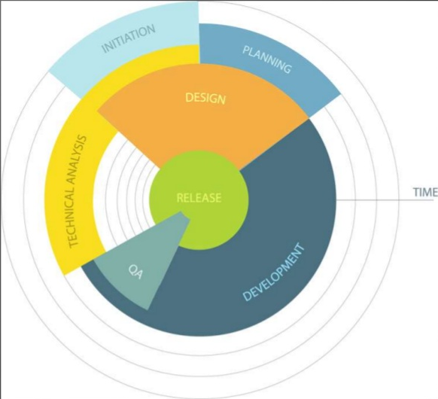
MOBILE APPLICATION DEVELOPMENT LIFE CYCLE (MADLC)

Slide 4
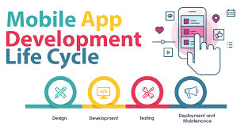
MOBILE APP DEVELOPMENT PHASES
A mobile app development life cycle usually consists of the following phases:
Planning & Research Phase
Prototyping
Assessment & Technical Feasibility
Building a Prototype
Designing & Development of App
Building App using Agile Methodology
Testing the Mobile App
Launch the Mobile App

Slide 5

PLANNING & RESEARCH PHASE
Essential phase because you lay down the necessary groundwork for what is to follow next.
Refine idea into solid basis for an application.
Do initial analysis, research and brainstorming.
During each stage of the process, keep the end user in mind.
Study details of your competitor’s app will help you figure out what features are absent in their app.
Notes:
All apps start with an idea, even if yours is just to have a mobile app presence. Refine that idea into a solid basis for an application. Make sure your initial analysis includes actual demographics, motivations, behavior patterns and goals of your buyer personal. During each stage of the process, keep the end user in mind. Now, try to think of your customer’s lifecycle, once their characteristics are pinned down. After you reach them, they need to be acquired, converted, retained and their loyalty nurtured. By the end, you should understand how the customer will be using the digital product. Doing this at the very onset will set you on firm footing, and your clarity will give you and your investors, much-needed confidence.
This phase is essential because, during this phase, you lay down the necessary groundwork for what is to follow next. Do your bit of substantial research and brainstorming before moving on to the next phase. And another important part of this phase is analyzing the competition. A detailed study of your competitor’s app will help you figure out what features are absent in their app so that you could include it in your app, to make it stand out.

Slide 6
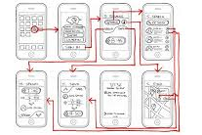

PROTOTYPING
Drawing detailed sketches or storyboard of the envisioned product helps you uncover usability issues.
It can be a powerful communication and collaboration tool.
Will help refine the ideas and arrange all components of the design in the right way.
Can overcome any technical limitation found in the backend development process
Notes:
The next step is to document and wireframe the app, to understand future functionalities. Although time is not on your side at this point, actually drawing detailed sketches of the envisioned product helps you uncover usability issues. Sketching does a lot more than merely tracing your steps. It can be a powerful communication and collaboration tool. When you're done sketching, wireframing will help refine the ideas and arrange all components of the design in the right way. You can overcome any technical limitation found in the backend development process in this initial phase. Now, aim to develop a clear understanding of how your proposed features and ideas will fuse together into a functional app. You should also create a roadmap or a storyboard, to demonstrate the relationship between each screen and how the users will navigate through the app. Look for opportunities to incorporate your brand, focus on the user experience and keep in mind the differences in the way people use a mobile app versus a mobile website.

Slide 7


ASSESSMENT & TECHNICAL FEASIBILITY
To know whether the idea of your application is feasible technically.
By the end of this exercise, the team may have different ideas for the app or decided that some of the initial functionality isn’t feasible.
At this point, brainstorm a little, ask questions and review the status.
Notes:
You might have a clear understanding of the visuals by now, but you also need to consider if the back-end systems will be able to support the app’s functionality. To know whether the idea of your application is feasible technically you need to get access to public data by sourcing public APIs. An app, depending on its format (smartphone, tablet, wearables, etc.) as well as the platform (iOS, Android, etc.), will have different requirements. By the end of this exercise, the team may have different ideas for the app or decided that some of the initial functionality isn’t feasible. At this point, brainstorm a little, ask questions and review the status.

Slide 8


BUILDING A PROTOTYPE
Experience the touch of the App.
Get the app concept into a user’s hands as quickly as possible to see how it works for the most common use case.
Notes:
Build a rapid prototype. Rapid is the key word here. You can't truly comprehend the touch experience until and unless you touch the App and see how it works and flows. So, build a prototype that gets the app concept into a user’s hands as quickly as possible to see how it works for the most common use case. Use rough and not exhaustive wireframes for this phase. This will help you see if you are taking things in the right direction. Include the stakeholders in this process, allowing them to touch the prototype will give you their feedback and implement it into your work. And moreover, the prototype will give different stakeholders the first look at your app and will help you validate the information you’ve gathered.

Slide 9

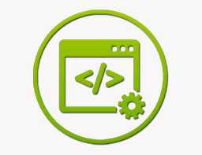
DESIGNING AND DEVELOPMENT OF APP
Designing user experience (UX) and user interface (UI).
Get blueprints and visual direction.
The development phase generally starts quite early on.
In the initial stage, the core functionality although present is not tested.
In the second stage, much of the functionality proposed is incorporated.
Notes:
DESIGNING
Once you get this step out of the way, you can dive into coding. Your user experience (UX) designer architects the interaction between design elements, while the user interface (UI) designer builds the look and feel of your app. This is a multistep process with its many review stages. What you get is blueprints and visual direction, informing your engineers of the envisioned final product and about how interaction should move, feel and flow. Depending on your project scope and app budget, this design phase can be completed in a single afternoon or can take a team a whole lot of hours. And remember to create multiple variations of a screen by playing around with the layout of navigation, buttons and other visual elements. The more your product varies, the higher the chances of your UX being original. Application designing will prove to be a multi-step process, and your results should be clear visual directions providing an abstraction of the final product.
DEVELOPMENT
The development phase generally starts quite early on. In fact, once an idea gains some maturation in the conceptual stage, a working prototype is developed which validates functionality, assumptions, and helps to give an understanding of the scope of work.
As the development progresses, the app goes through a set of stages. In the initial stage, the core functionality although present is not tested. See the app is very buggy, and non-core functionality doesn’t exist at this point. In the second stage, much of the functionality proposed is incorporated. The app has ideally gone through light testing and bug fixing, though some issues could still be present. In this phase, the app is released to a certain group of external users for more testing. After the bugs in the second stage are fixed, the app will move to the deployment phase where it’s ready for release.

Slide 10
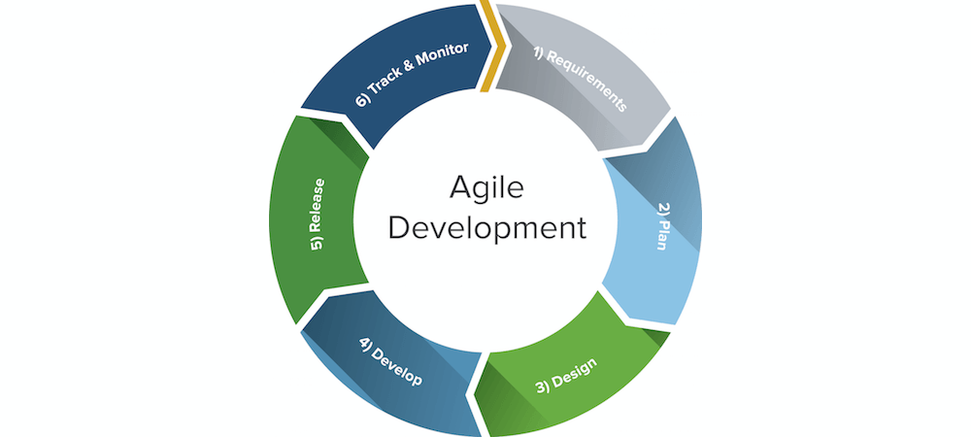
BUILDING APP USING AGILE METHODOLOGY
Agile practitioners generally split one large module into smaller chunks so that task can be performed into easy and efficient way.
Following Agile Methodologies for mobile application development can be quite advantageous as while development, integrating documentation and quality testing can be done at every step.
Notes:
Agile Development can be defined as the combination of several development strategies to make the task easier.
If yours is a complex project where user requirements change regularly, make use of agile methodology. It helps with flexible planning, progressive development, early deployment and constant improvements. A large application can be broken down into smaller modules, and agile methodology can be applied to each of these small parts.

Slide 11

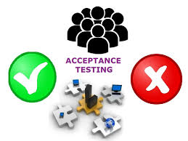
TESTING THE MOBILE APP
It’s a good idea to test early and often.
The application should be tested for usability, compatibility, security, interface checks, stress, and performance.
In user acceptance testing you discover whether your mobile app works for your intended users or not.
Further make your application available for a beta trial.
Notes:
In mobile app development, it’s a good idea to test early and often. Doing this will keep your final costs low. The farther in you go into the development cycle, the costlier it becomes to fix bugs. Refer to the original design and planning documents while building out the various test cases.
Application testing is vast, so make sure your team covers all the necessary facets of it. The application should be tested for usability, compatibility, security, interface checks, stress, and performance. In user acceptance testing you discover whether your mobile app works for your intended users or not. To test this give your app to a few people in your target audience and ask pertinent questions. Once your application passes the user acceptance test, you know your solution “works.” And further make your application available for a beta trial, either through the enrollment of previously identified groups or an open solicitation for participants. The feedback you receive from beta users will help you find out whether the app’s functions are operating well in a real-world situation.

Slide 12

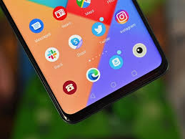
LAUNCH THE MOBILE APP
Ready to submit.
Keep in mind, this is not the end.
As your application gets in the hands of users, feedback will pour in, and you will need to incorporate that feedback into future versions of the app.
Typically, as soon as the first version of the app is released, the development cycle begins a new.
Notes:
Your app is ready to submit. Choose a day and key up a formal launch. For different application stores, the policies of launching an application are different. And keep in mind, this is not the end. App development doesn’t end at launch. As your application gets in the hands of users, feedback will pour in, and you will need to incorporate that feedback into future versions of the app. Every app will need updates and new features. Typically, as soon as the first version of the app is released, the development cycle begins anew. Make sure you have the resources to maintain your product. Apart from the money invested in building a digital product, keep in mind that its a long-term commitment.

